Slide 1

IT Ticket Analysis: Insights and Dashboard Presentation
Exploring trends and insights from IT Ticket Data- Performance, Efficiency, and Satisfaction Insights
Shobha Vyshnavi

Slide 2

Agenda
01 | Introduction & Objectives
02 | Key Findings and Insights
03 | Trend Analysis
04 | Agent Performance Analysis
05 | Recommendations and Action Plans
06 | Dashboard Overview and Functionality

Slide 3
Introduction & Objectives

Slide 4
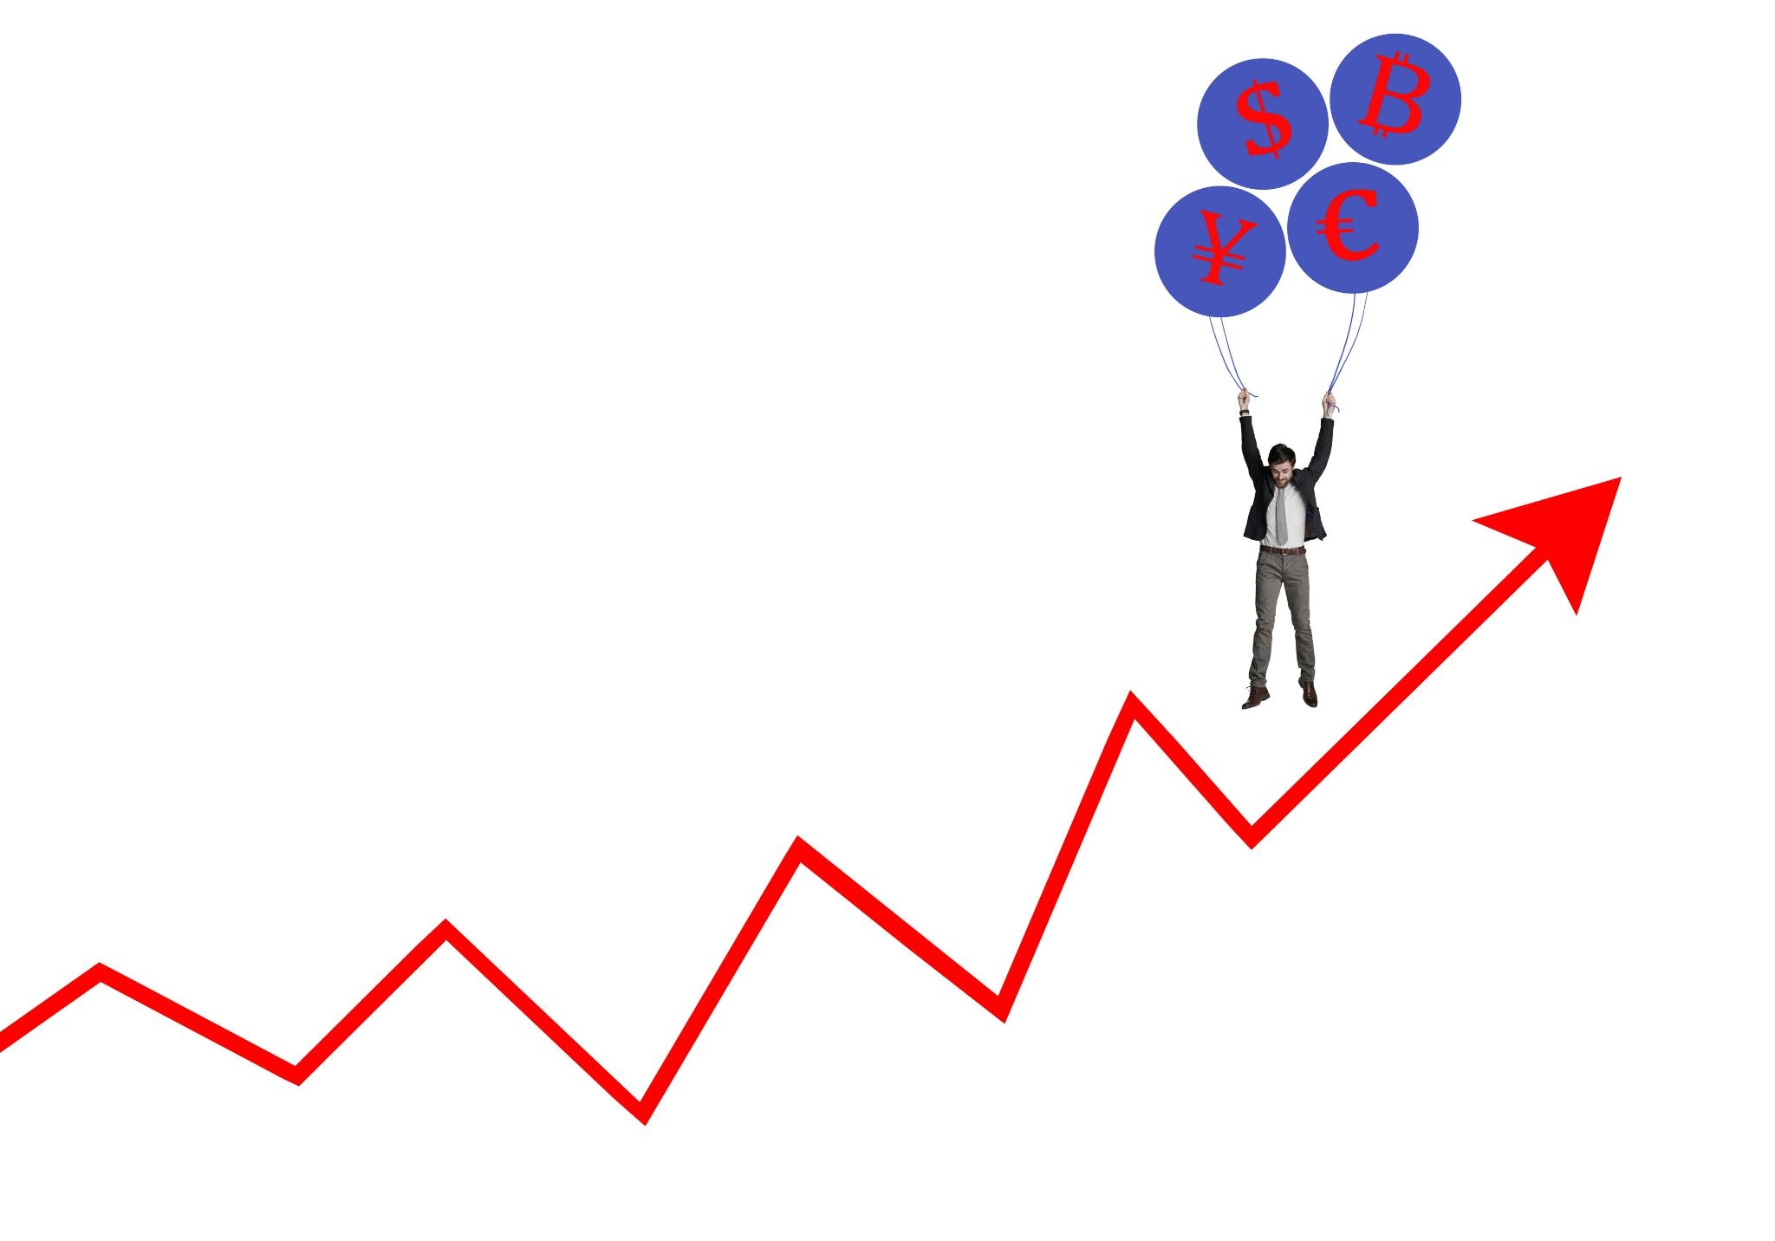
Purpose and Objectives of the Analysis
Evaluate IT Support Efficiency
The analysis aims to assess how efficiently our IT support processes operate, ensuring optimal service delivery.
Identify Trends
We aim to uncover trends in IT support requests and responses to better understand user needs and behaviours.
Areas for Improvement
The analysis will highlight areas needing improvement in IT processes to enhance service quality and responsiveness.
Align IT with Business Needs
Our objective is to ensure that IT services are aligned with current business requirements and priorities for better integration.
Identify high and low performing agents
The analysis aims to identify high and low performing agents to support staffing decisions, including hiring, firing and training.

Slide 5
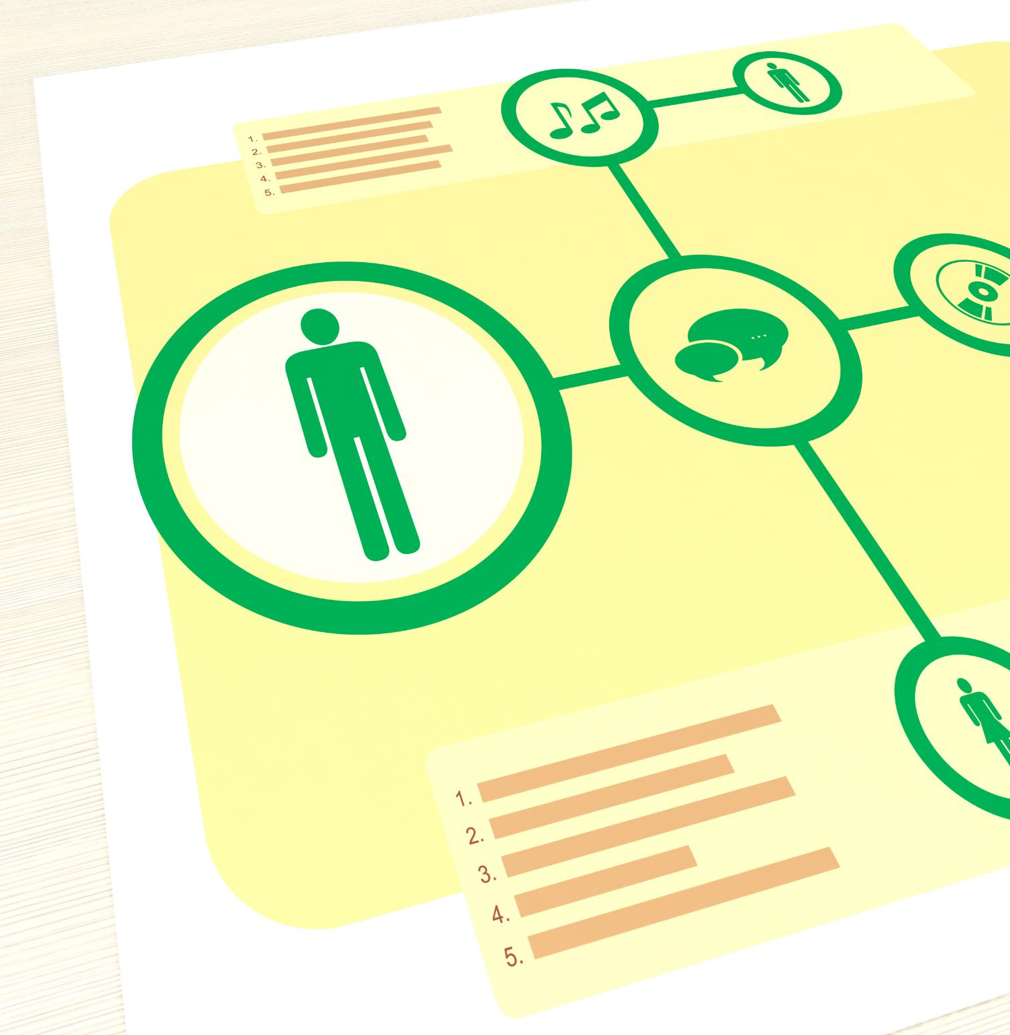
Overview of the Data Collection Process
Data Sources
Data was collected from multiple sources such as the ticketing system, user feedback, and service agreements to ensure comprehensive analysis.
Comprehensive View
The gathered data provides a holistic perspective on how tickets are handled and resolved, improving our understanding of the process.

Slide 6

Data Overview
Ticket Dataset
Ticket data contains records of support requests, including ticket category, issue type, resolution times, and satisfaction rate.
Agent Dataset
Agent data includes information on individual agents, their birth years, and contact details.
Data Analysis
Analysing these datasets can identify trends, improve service delivery, and enhance agent performance.

Slide 7
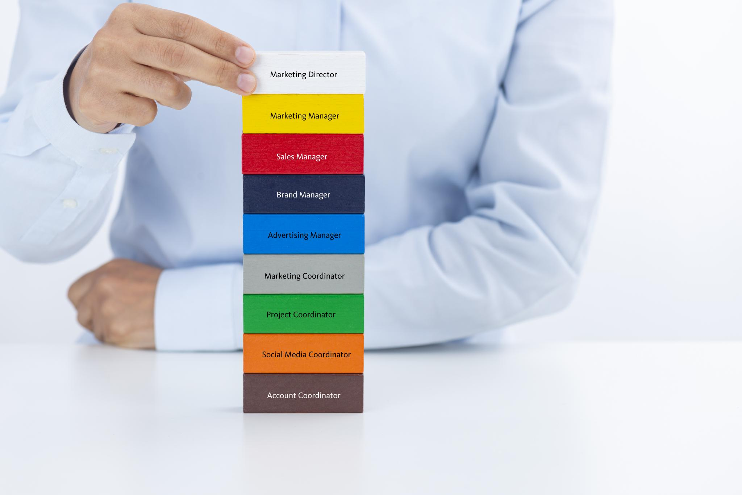
Key Metrics and KPIs
Ticket Volume
Ticket volume measures the total number of support requests received, indicating workload and demand on the IT team.
Resolution Times
Resolution times refer to the average time taken to resolve support tickets, reflecting efficiency and service quality.
Customer Satisfaction Scores
Customer satisfaction scores provide insight into user experiences, helping assess the effectiveness of support services.

Slide 8
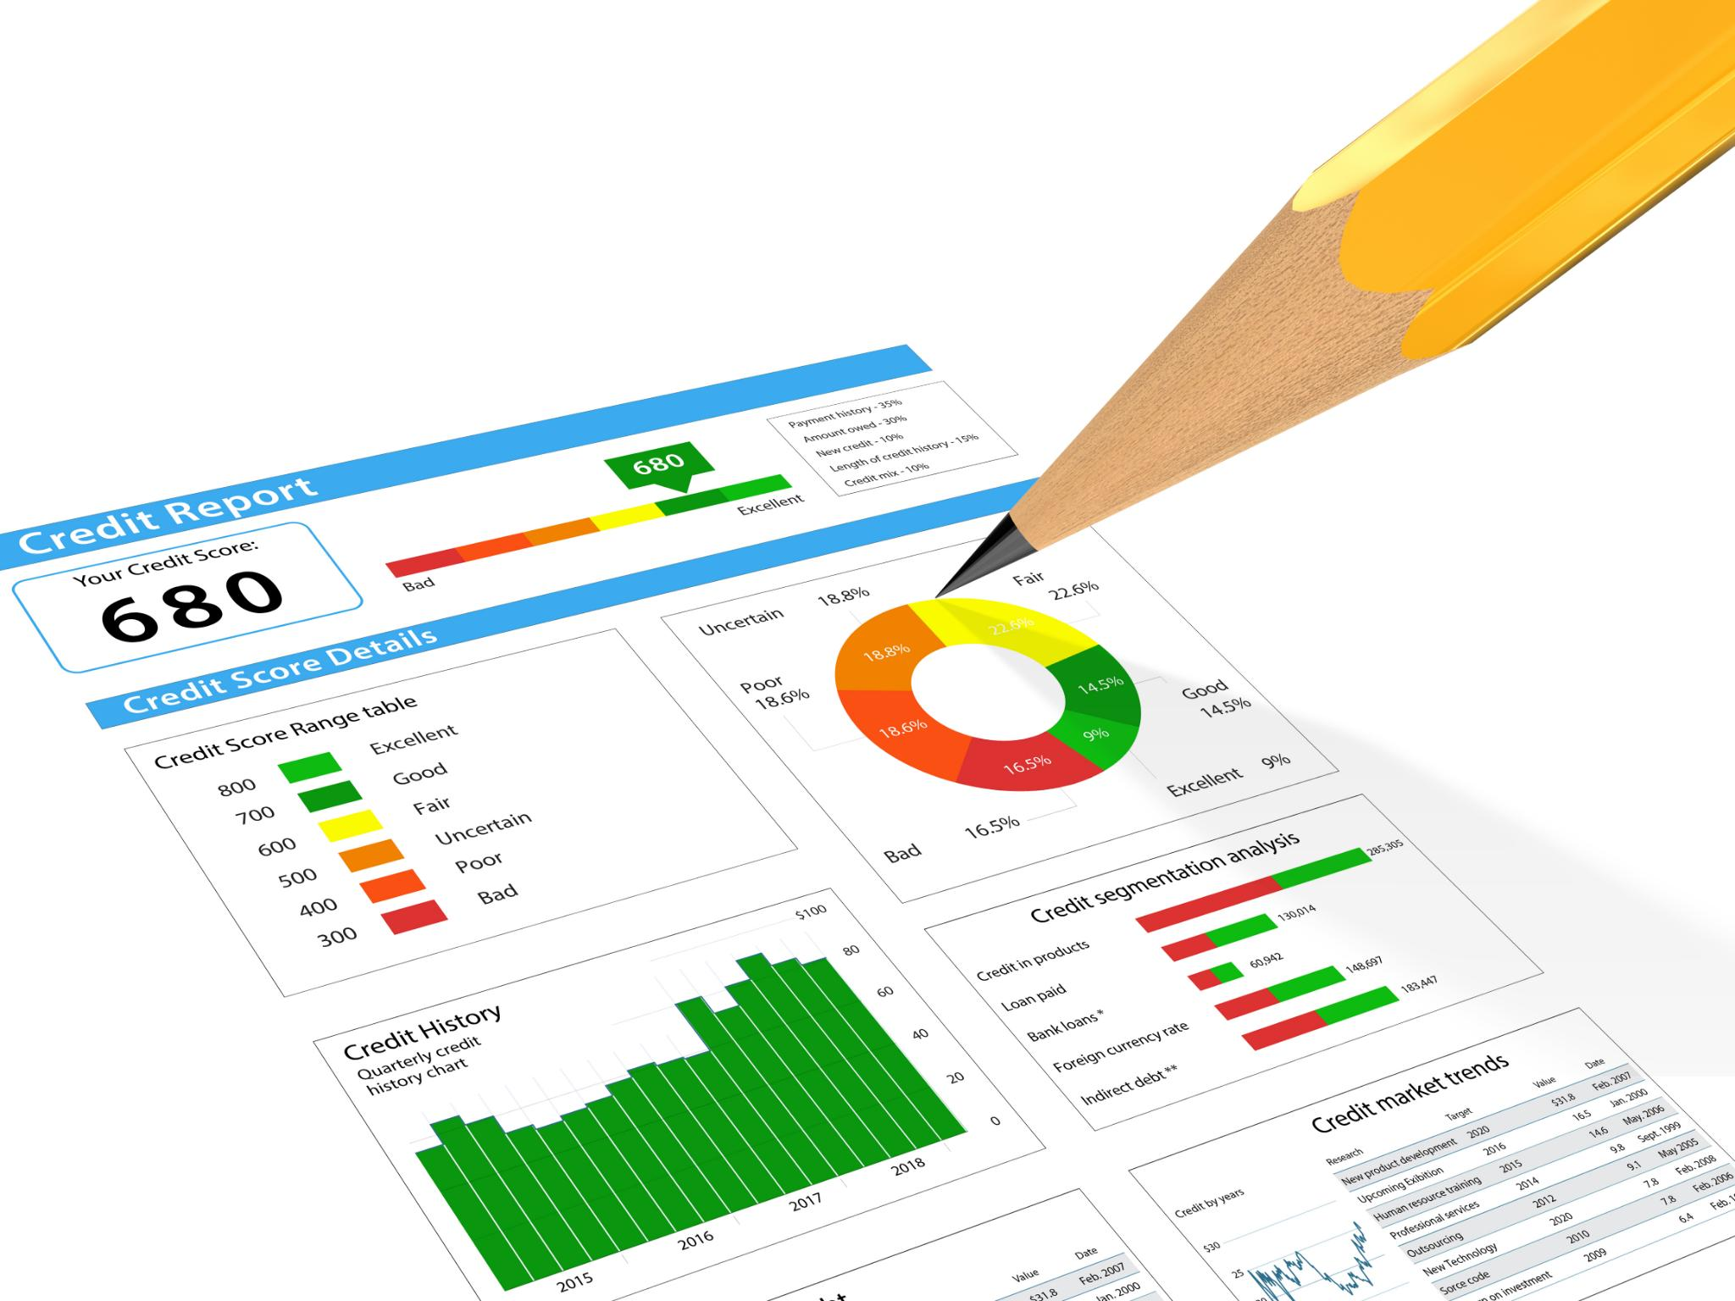
Methodology Overview
Data Cleaning
Addressed inconsistencies in data, such as correcting 'mayor' to 'major' in the Severity column to ensure accuracy.
Statistical Analysis
Explored correlations, averages, and trends, such as the relationship between Severity and Resolution Time.
Pivot Table Insights
Identified trends in ticket volumes, agent performance, and satisfaction metrics using pivot tables.
Data Visualization
Created line charts and bar graphs to illustrate temporal trends and data distributions effectively.

Slide 9
Key Findings and Insights

Slide 10
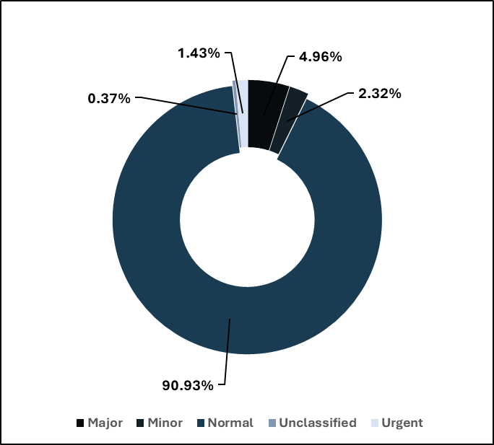
Ticket Volume and Distribution
Total Tickets Logged: 97,498
Our IT support team has handled a substantial volume of 97,498 tickets over the span of 5 years. This high number indicates the significant demand for IT support services within our organization.
Majority of tickets are of 'Normal' severity.
Urgent tickets are minimal but require faster resolution.

Slide 11
Average Resolution Time
Average Resolution Time: 4.55 days
On average, it takes our team 4.55 days to resolve a ticket. This metric is crucial as it reflects the efficiency of our support processes.
Improved Efficiency
The average resolution time for tickets has shown a positive trend, reflecting our team's efficiency improvements over the last quarter.
Ongoing Challenges
Despite overall improvements, certain ticket types still present challenges and require further analysis and attention.

Slide 12

High Satisfaction Rate
High Satisfaction Rating
Users have rated our support services an average of 4.10 out of 5, indicating high satisfaction.
Quality Support
High satisfaction suggests quality support services that meet user expectations.
Continuous Improvement
Regular feedback, timely responses, and continuous improvement initiatives sustain high performance.

Slide 13
Trend Analysis

Slide 14
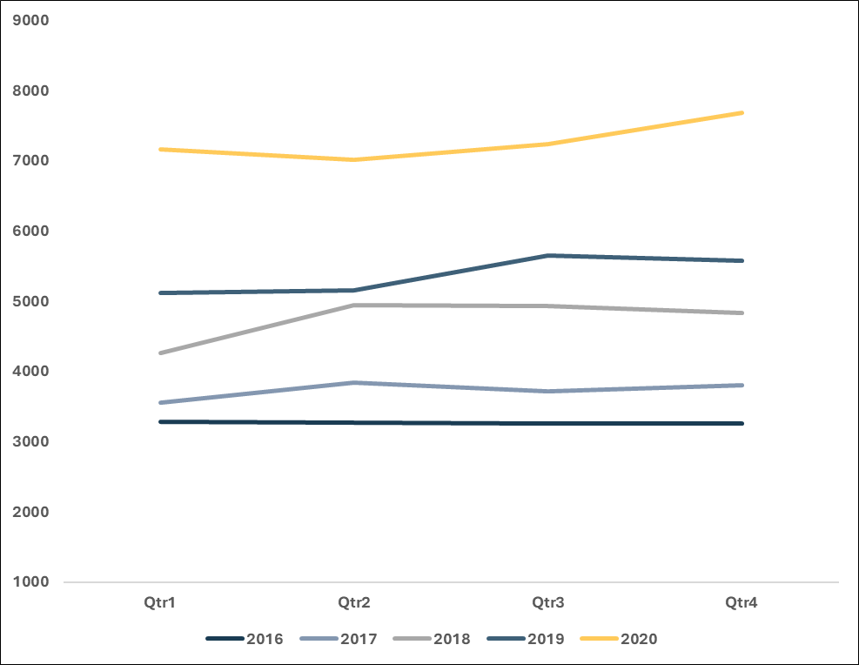
Quarterly Trends
An overview of quarterly trends, highlighting significant seasonal variations and support request patterns.
Ticket Volume over Quarters
Ticket Volume has increased over quarters for every year

Slide 15
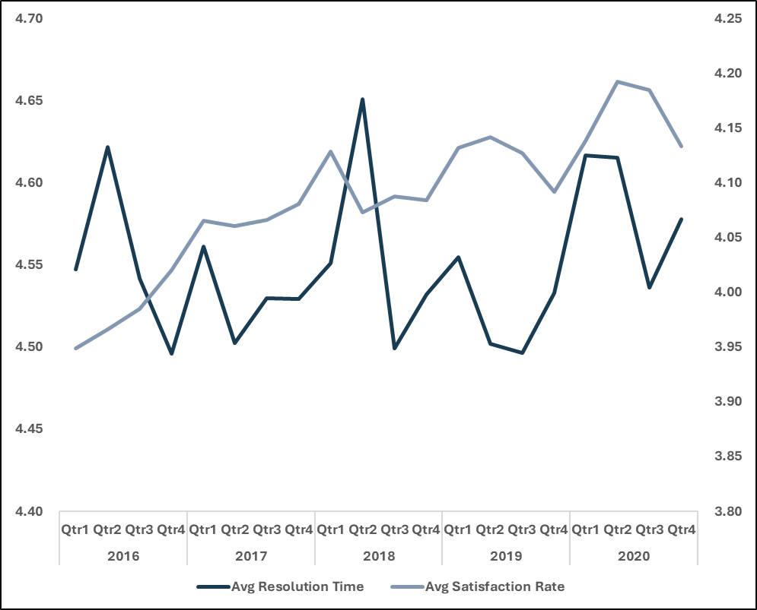
Quarterly Trends
An overview of quarterly trends, highlighting significant seasonal variations and support request patterns.
Average Resolution Time over Quarters
Avg Resolution time does not show any pattern
Avg Satisfaction rate has increased over time stating improved support service.

Slide 16
Agent Performance Analysis

Slide 17

Agent Performance Insights
Top Performing Agents
Diana Rojo, Javier D., Jesus Grajeda, Galindo Guadalupe, and Segura Garcia deliver high satisfaction and fast resolutions.
Agents Needing Improvement
Lorena, Elena Velez, Nurio Zepeda, Sandra Lujan, and A. Trejo require additional training to improve performance.

Slide 18
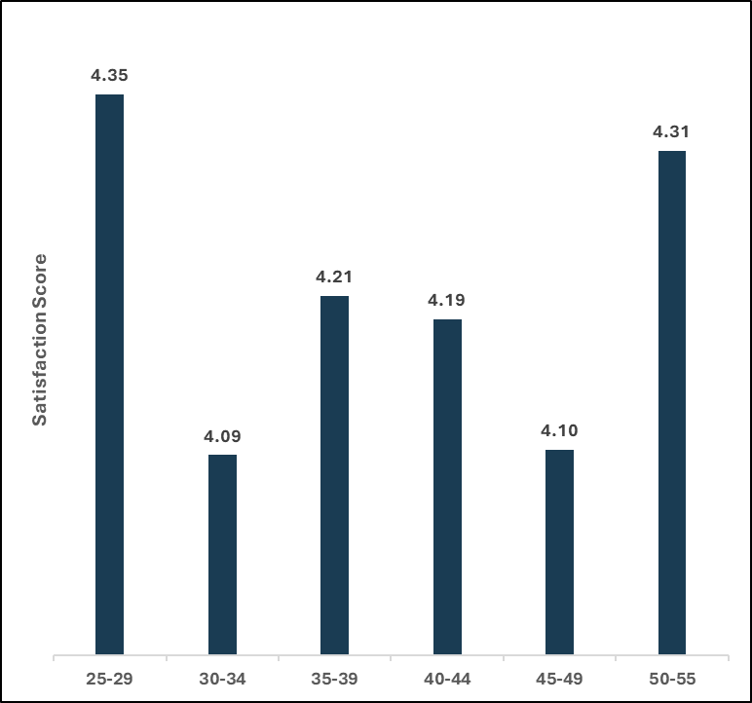
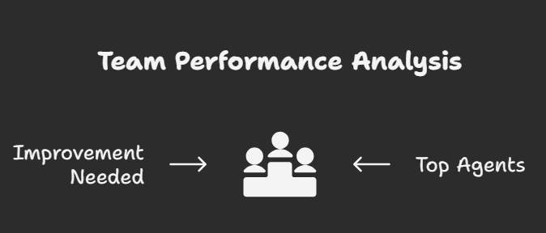
Agent Performance based on Age Groups
The satisfaction rate tends to increase with age. This trend may indicate that experience, training maturity, or work habits contribute positively to customer satisfaction.

Slide 19
Recommendations and Action Plans

Slide 20
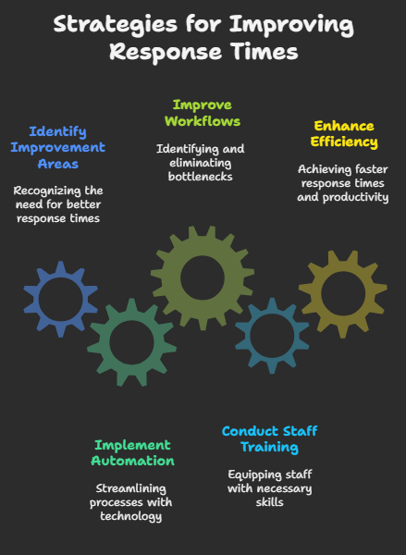
Strategies for Improving Response Times
Automation Implementation
Implementing automation in workflows can streamline processes, leading to significantly reduced response times for support teams.
Workflow Improvement
Improving existing workflows helps identify bottlenecks, enabling faster response times and higher productivity.
Staff Training
Regular training for support staff equips them with essential skills and knowledge, enhancing overall efficiency and service quality.

Slide 21
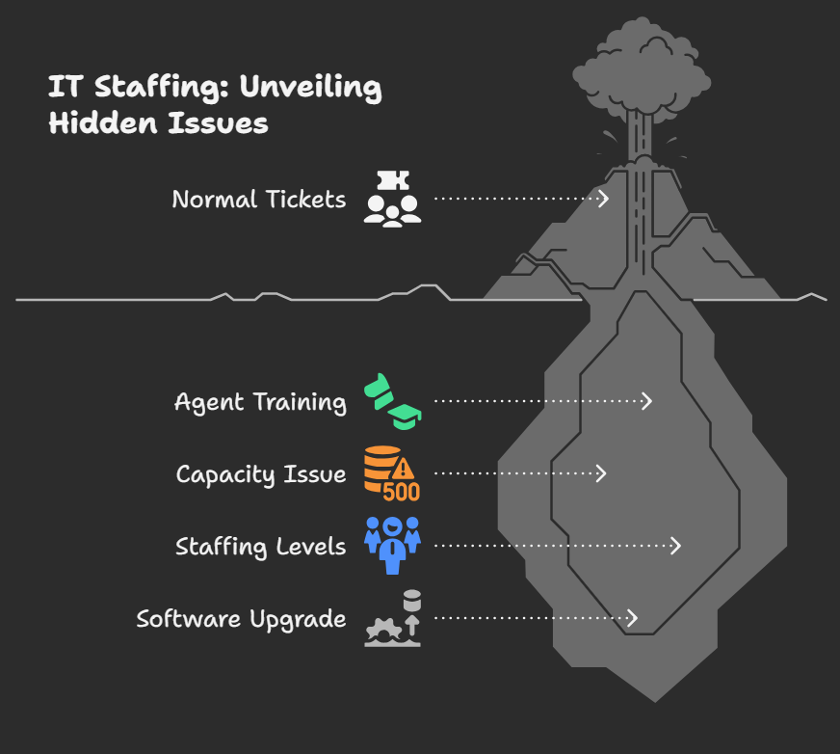
Investment Insight: IT Staffing
Dominance of Normal Tickets
Normal severity tickets form the majority of the volume, with an average resolution time of 4.66 days.
Satisfaction Rates Comparison
Satisfaction rates are higher for Major and Urgent tickets, indicating well-trained agents handling these efficiently.
Capacity Issue Insight
The long resolution time for Normal tickets suggests there might be a capacity issue needing attention.
Hiring and Upgrading
Increasing the number of IT agents may improve resolution times and customer satisfaction, however, upgrading software and enhancing training could also streamline operations at a lower cost.

Slide 22

Enhancing Support Team Performance
Culture of Continuous Improvement
Promoting a culture of continuous improvement encourages team members to enhance their skills and service delivery.
Accountability in Teams
Fostering accountability within the support team ensures that team members take responsibility for their actions and service quality.
Improved Service Delivery
Enhanced team performance results in better service delivery, directly affecting user satisfaction and loyalty.

Slide 23
Long-Term Improvements and Goals
User Education
Investing in user education can empower users, leading to fewer support tickets and improved IT efficiency.
Self-Service Options
Implementing self-service options allows users to resolve issues independently, reducing the workload on IT support teams.
Enhanced IT Support
Long-term goals focused on education and self-service can lead to more effective IT support and higher user satisfaction.

Slide 24
Dashboard Overview

Slide 25
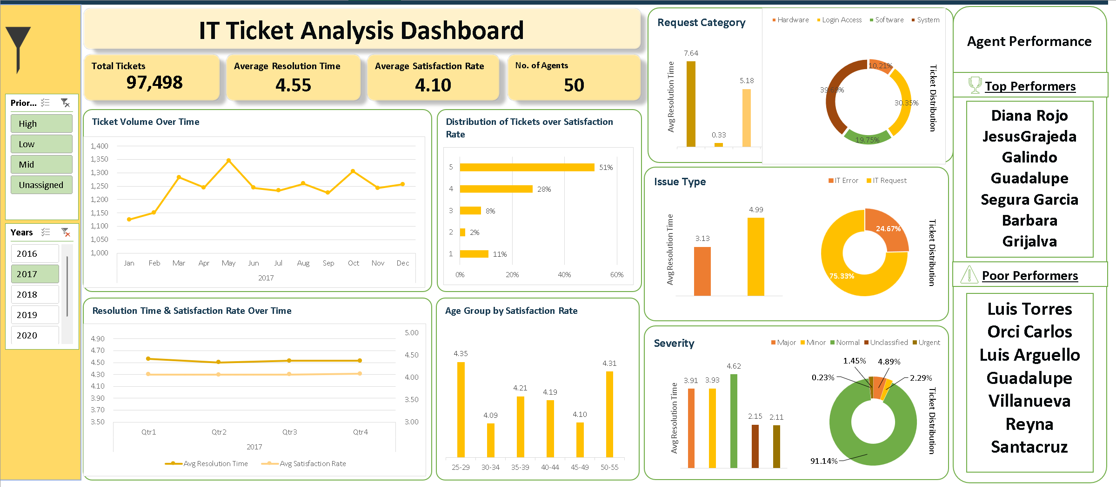

Slide 26
Conclusion
Data-Driven Insights
Our analysis uncovers valuable insights that can lead to informed decision-making by the leadership team.
Key Findings
Addressing the key findings from our analysis is essential for improving IT support services effectively.
Enhanced User Satisfaction
Implementing our recommendations can significantly enhance user satisfaction and overall IT service experience.

Slide 27
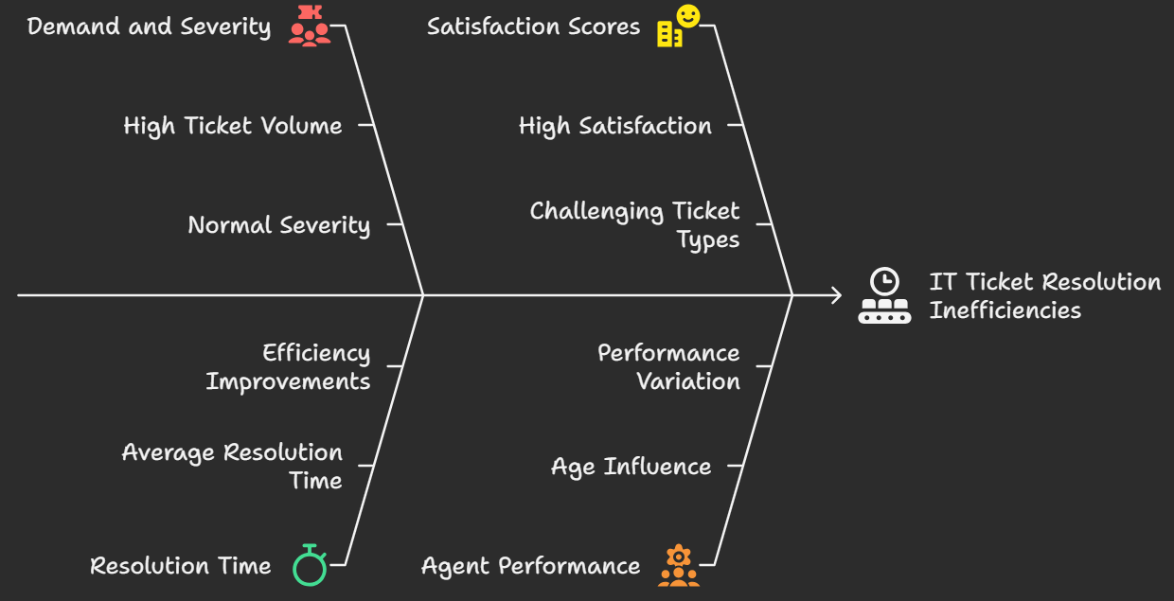
Key Findings
High Demand and Severity
The analysis of 97,498 IT tickets revealed a high demand with most tickets categorized as normal severity.
Resolution Time Efficiency
The average resolution time is 4.55 days, indicating improvements in efficiency within the IT support teams.
Satisfaction Scores
High satisfaction scores suggest good service quality, although some ticket types remain challenging to resolve.
Agent Performance Variation
Agent performance varies by age, influencing both satisfaction scores and resolution times. This insight can inform staffing and training decisions.
This analysis underscores the power of data-driven decision-making in transforming IT support—enhancing service quality, boosting team performance, and driving strategic growth.

